Slide 1

District Conventions 2024
Notes:
Hello, I’m Jeremy Angle and I have the privilege of serving as President at Northwestern Publishing House. Thank you for allowing me to share a little bit about this past year of your Synod’s publishing house.
But before we take a journey back, let’s remember the mission of Northwestern Publishing House.

Slide 2


Notes:
For 133 years our mission has not changed … to deliver biblically sound Christ-centered resources within our Synod and beyond.
We can not fulfill our mission without your support and partnership.
As new leadership took the helm 2 years ago, it allowed us to revisit our vision for NPH which was introduced at last year’s Synod Convention. For those not in attendance, let me share that with you now.

Slide 3

Notes:
Our vision for NPH is to be the first choice people go to for digital and printed resources that share Christ’s truths worldwide.
We purposefully use the words “first choice” because we know there are countless choices available but we want our members and others outside our Synod looking to NPH first. As we know we have the purest Gospel message. And notice we say, “people” not Christians or WELS members? Why? We don’t know who will possibly stumble upon us and we want to be ready with the greatest resources to allow the Holy Spirit to do his work. And as the WELS Constitution states, NPH is to serve the synod’s gospel ministry AND also other Christians and unchurched.
So how are we doing this – we are working to enhance our digital, social footprints. As well as expand our reach nationally and globally. We have partnered with 2 specific outside vendor who are working with us to expand our reach within and outside our Synod walls. A digital marketing firm that is assisting us expanding our digital footprint through Google and various social media channels. And a outside distribution and sales company helping us expand the reach of our titles through local and national retailers. As well as, distribute select titles directly in to the UK and other English speaking countries around the world. The titles entering the UK were hand selected by our ministry team in the UK, led by Pastor Michael Hartman.
We ask for your prayers and will continue to work as hard as we can and seek God’s way and timing.
Just as we renewed and revamped our vision. We did the same for our values to help drive our everyday decisions…

Slide 4


Notes:
(READ THEM)
Now, let’s take a journey back and highlight a few resources published by NPH to support and strengthen your faith in Jesus and teachings of the Bible.

Slide 5


Notes:
The Baptismal Life by the Rev. Dr. Michael Berg. As Dr. Berg describes. Water is everywhere in the Bible. Whether it’s literal H₂O or water as a motif, the pages of God’s Word are saturated with the stuff. This water kept—and keeps—God’s people alive not just physically, but spiritually as well. Additionally, each chapter offers astute connections to the baptismal sacrament and useful takeaways for a Christian life.
(PAUSE)
At Home with the Psalms contains 100 interactive family devotions and will equip your whole family for the joys and sorrows of life, building up praise and thanks in your hearts through God’s Word.
(PAUSE)
The Heart of Faith is a devotional book with favorite Bible chapters focusing on core concepts of Christianity: forgiveness of sins, Jesus' earthly ministry, his death and resurrection, and salvation for all who believe. Exploring these life-giving themes as found in Psalm 51, Mark 15, Luke 2, and other parts of the gospels. Encouraging you to put your faith into action through personal application sections.
(PAUSE)
In partnership with Christian Aid and Relief. An Ever-Present Help in Trouble contains 40 devotions that offer gospel comfort for any kind of personal or widespread crisis, whether economic, natural, medical, a loss, or another traumatic experience. The reflections share the comfort of God’s love and providence with those suffering from life’s disasters. The back of the book features prayers that ask God for help in various times of disaster.

Slide 6
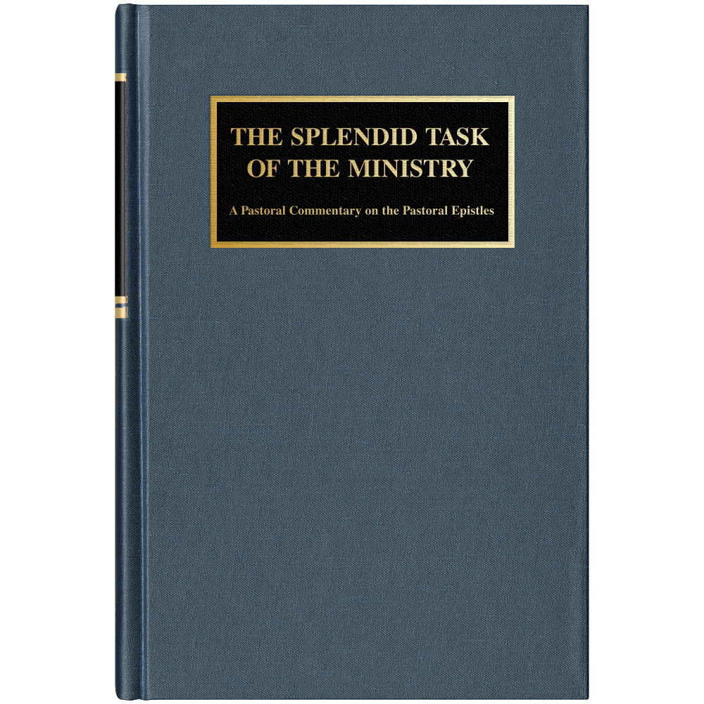
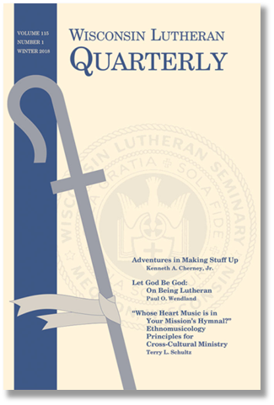
Notes:
Professional Resources for our pastors to support their study of God’s word and help them grow in their ability to serve those they shepherd. And that is not to say these are only for pastors, staff ministers and teachers. The advanced lay person eager to dive deep in their personal studies, can use these as well.
(PAUSE)
Written from a caring, pastoral perspective, Professor David J. Valleskey's The Splendid Task of the Ministry offers insightful, practical applications to the pastoral ministry of today from the New Testament books of 1 and 2 Timothy and Titus.
(PAUSE)
Written by popular NPH author Daniel Deutschlander as one of his final works, Your Kingdom Come offers a thought-provoking yet easy-to-read explanation of the passages of St. Mark's gospel.
Drawing directly from the Holy Bible, this commentary features helpful (and sometimes surprising) insights from Deutschlander with cross references to the gospels of Matthew, Luke, and John for added context. This book also contains an appendix featuring an essay that summarizes and supplements another of Deutschlander's most popular works The Theology of the Cross: Reflections on His Cross and Ours.

Slide 7



Notes:
A presentation from NPH wouldn’t be complete without talking about the newest hymnal for our Synod. I’m only going to highlight 2 products within the suite of products available within Christian Worship.
Christian Worship: Musician’s Resource was launched in June of 2022 with approximately 200 various downloadable resources, it has now eclipsed 1500 resources and will continue to grow over the years. All of which our downloadable via the NPH website. These include alternate accompaniments, instrumental arrangement, and more.
Christian Worship: Service Builder is helping 50% of WELS congregations save time and collaborate more efficiently when putting together their weekly worship service and bulletins. Which can be enhanced by the 31 beautiful icons artistically designed exclusively for Christian Worship. And I am happy to report that Service Builder is now eclectic for Bible readings. The 4 most popular translations are now embedded directly in to Service Builder. The translations that are joining NIV’11 are: CSB, EHV and ESV.

Slide 8
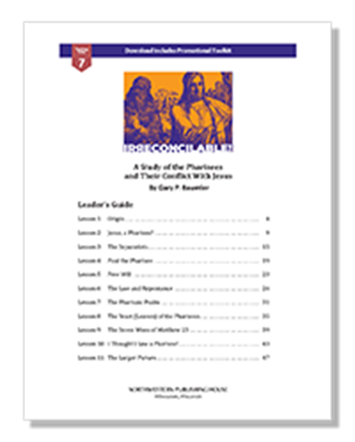
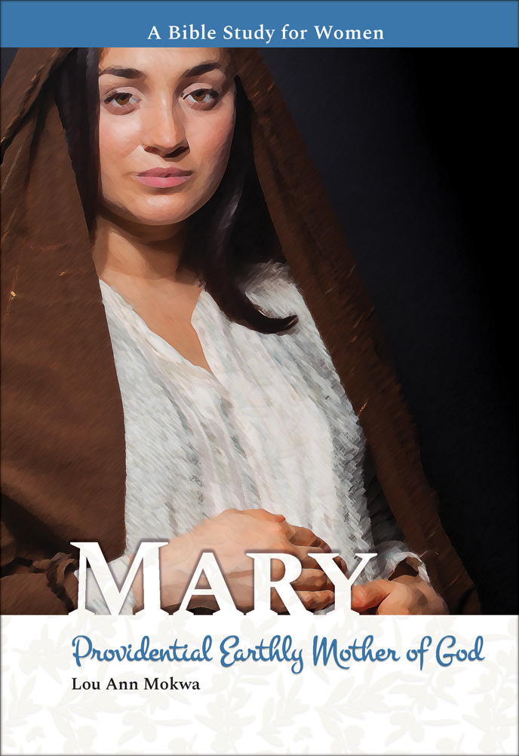
Notes:
Bible studies to assist pastors in their ministry and to assist and guide lay leaders in their small group studies
(Pause)
For centuries, Mary, the mother of Jesus, has been a hot topic of debate and division. However, the Bible shares exactly what we need to know about her: she was a fellow servant with other believers saved by God’s grace.
Join Lou Ann Mokwa, author of Esther: Providential Persian Queen, as she examines Mary’s life and her relationship to our Savior from what Scripture tells us in this eight-lesson Bible study.
(Pause)
And the 5-Minute Bible Study Series continues with one specific for Couples authored by Pastor Randy Hunter offers insightful one-page devotions to help engaged or married couples set aside special times each week to reflect on God’s Word and grow closer to each other. And the series will continue in to the coming years. The next in the series will be for Women. Which is being co-authored by multiple women and edited by Naomi Schmidt.

Slide 9
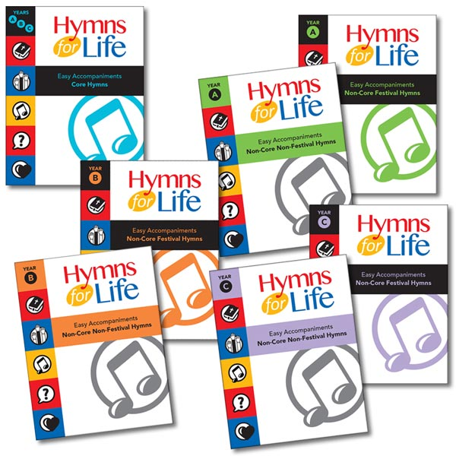
Notes:
A hymnology curriculum has been completed with the release of the final year of Hymns for Life, a three-year, three-level curriculum for K-8 that studies 90 hymns from Christian Worship. Each year and level (purchased separately) includes an extensive teacher's guide, student take-home sheets, mp3 accompaniments (for both organ and piano), sample vocal recordings for every hymn, 18 powerpoint background slides, a teacher's devotion for each hymn, a sample digital presentation, and more.
The Hymns for Life Easy Accompaniment series features the hymn melody alone in the right hand along with a two-note accompaniment in the left hand. Settings approximately equate to level 2 or 3 of popular piano study series. These settings can be used by teachers or students with limited keyboard development to accompany Hymns for Life curriculum hymns in their classrooms, or to supplement the hymn/repertoire collections of piano students.

Slide 10

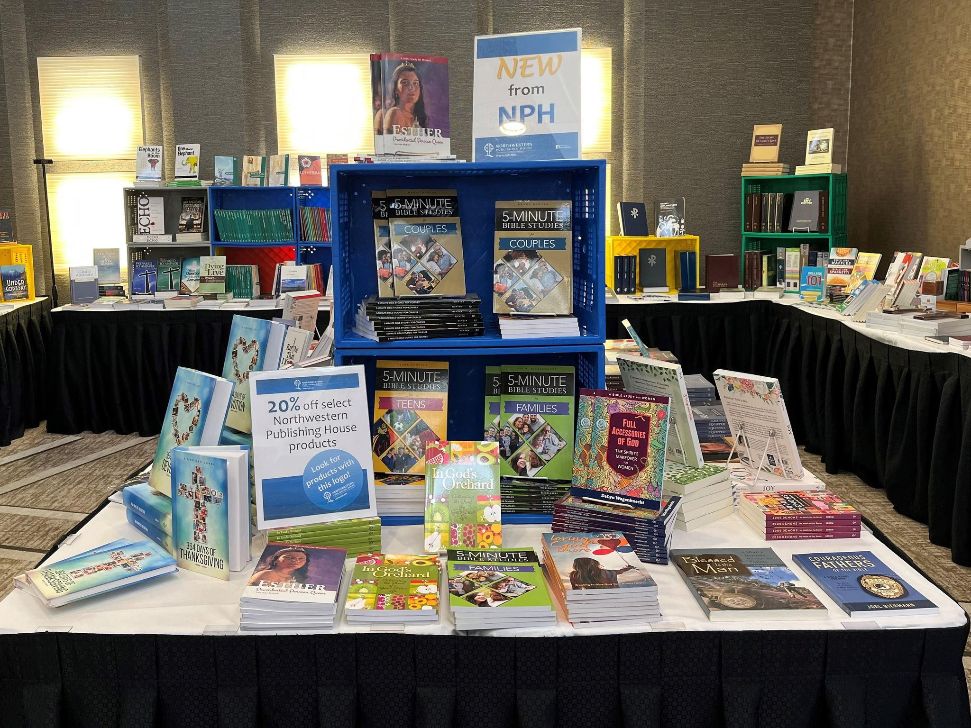
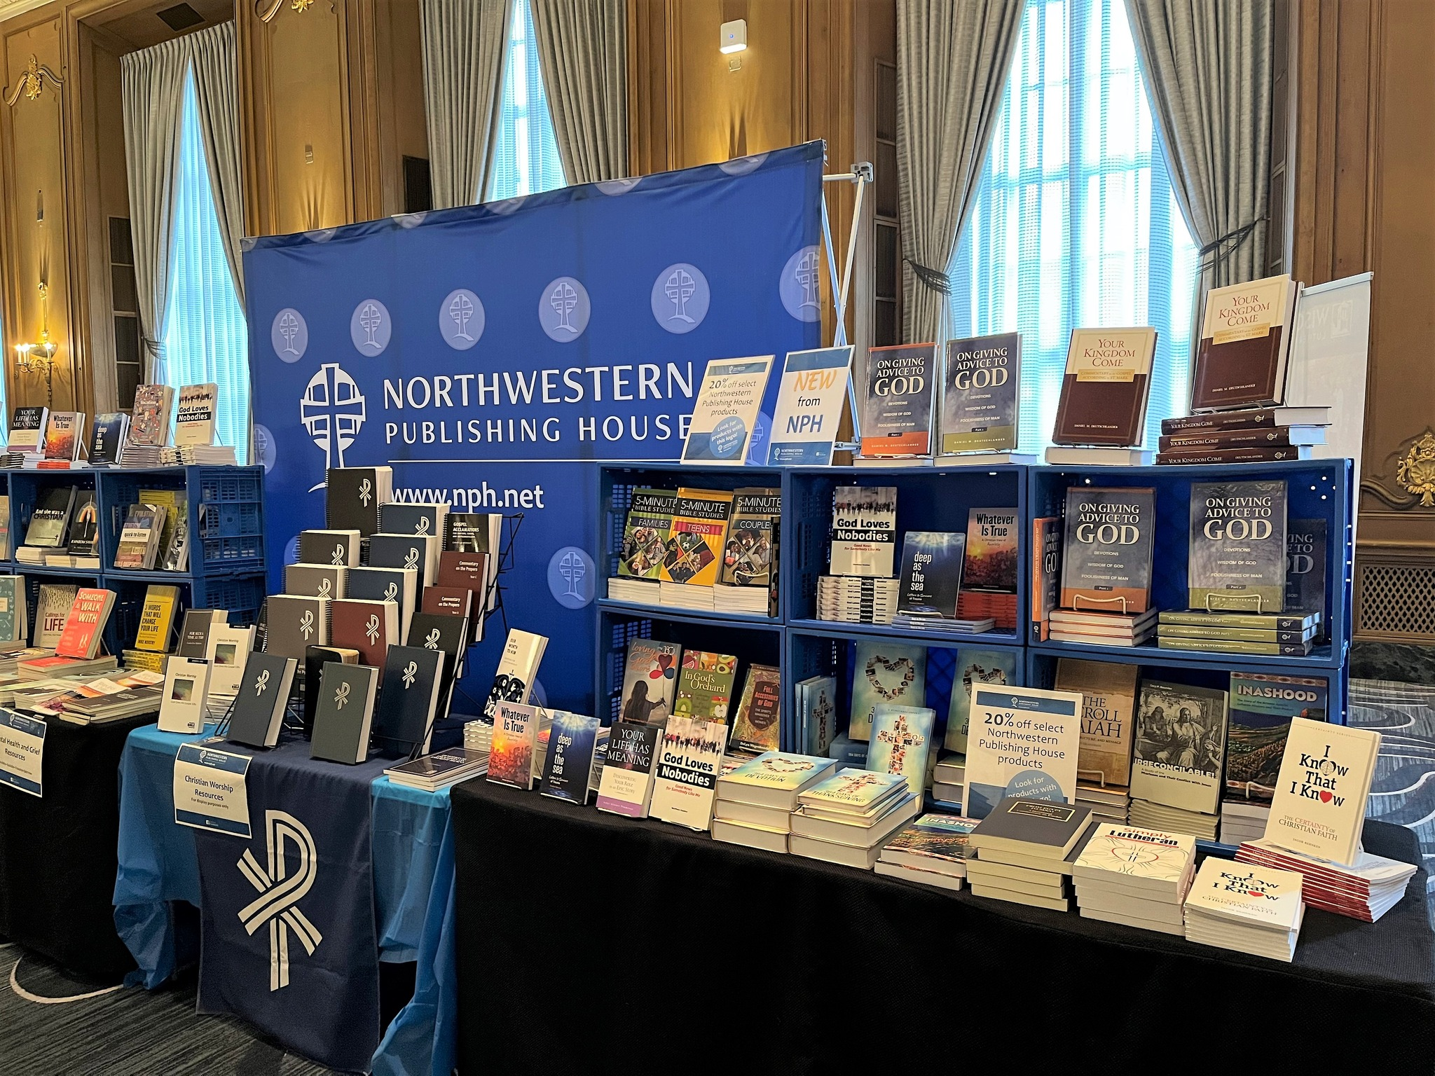
Notes:
NPH Book Fairs and Convention Displays are back in full swing. We do all we can to attend as many conventions and conferences as our schedule allows.
Don’t forget about NPH book fairs. These can be virtual or in-person. Give us a call, we would love to help you host one.

Slide 11

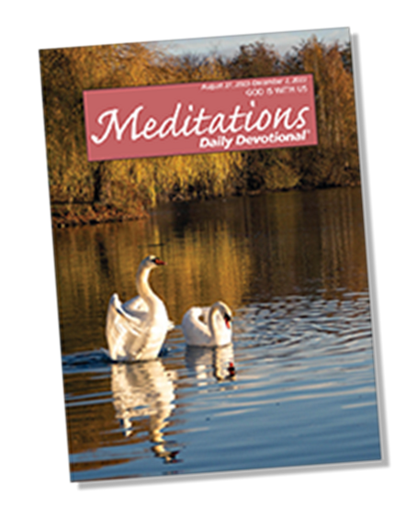

Notes:
In collaboration with Communication Services and the Conference of Presidents, NPH continues to publish the monthly edition of Forward in Christ.
Meditations Daily Devotional is an inspiring, personal devotional booklet offering daily Scripture-based, soul-searching studies of God's Word.
Forward In Christ and Meditations Daily Devotions is a staple in 10s of thousands of homes. But that is not enough for a Synod of our size. Subscribe, encourage those your shepherd and educate them on the importance of daily devotion and time with God.
Meditations and Forward in Christ make it simple for our members to spend time with God every day. And Meditations can also be downloaded and subscribed to on your smart phone.

Slide 12

A.I. in Christian Publishing
Notes:
Lastly, I’d like to briefly touch on AI in Christian Publishing and it’s threat to those we, you and I, shepherd.
We know false doctrine is all around us, we potentially encounter daily. Now open source A.I. is pulling from that false doctrine and publishing books, so called “Christian” books. Here’s the data. Prior to ChatGPT there were approximately 1.4 million self published books annually. Now, post ChatGPT, 2.3 million self published books hit the market every year. Many of those books that are self published are being written by AI. And the Christian market is not immune from the invasion of self published books via AI. It is our job, collectively, to point those we shepherd to NPH. NPH titles should not just be in your congregation and school libraries. They should be in every home of every family. As called workers and lay leaders, it is our collective responsibility to lead by example. So I ask … What NPH title are you currently reading? Are you subscribed to Meditations Daily Devotional and Forward in Christ?
Rest assured, everything published and made available through NPH is vetting for Scriptural and Doctrinal integrity and accuracy.

Slide 13
THANK YOU
Notes:
Thank you. It is an honor to serve you and your ministries.

Slide 14
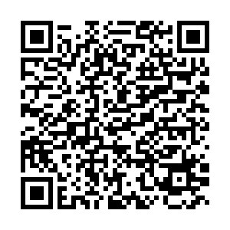
Scan the QR Code and enter your information to enter the drawing to win a $100 NPH Gift Card

